Slide 1

Project Title: BREATH CARE-AI-POWERED AUDIO BASED ANALYSIS APP FOR RESPIRATORY DISEASE PREDICTION
Batch-ID: 24
Student Team Members:
Bolenane Kusuma,2451-22-749-006
Police Karthik Reddy,2451-22-749-057
Guide: Name, Designation, Dept. of CSE/CSE-Allied, MVSREC

Slide 2
Contents
Abstract
Introduction
Literature Survey
System Architecture
Implemenation(Module(s) Description)
Results & Discusion(With Proper tables & Figures)
Conclusion & Future Enhancment
References
Github Link
Proof of Publication

Slide 3
Abstract
BreathCare predicts respiratory diseases using audio signals
Uses breathing/voice recordings as input
Applies preprocessing and feature extraction (MFCC, RMS, ZCR)
Uses machine learning model for classification
Detects conditions: Normal, Asthma, Bronchitis, Pneumonia
Provides fast and user-friendly prediction results

Slide 4
Introduction
Respiratory diseases affect millions of people worldwide
Early detection is essential for effective treatment
Traditional diagnosis requires medical expertise and equipment
BreathCare uses audio signals for disease detection
Machine learning is used to analyze breathing patterns
Provides a simple, fast, and cost-effective solution

Slide 5
Literature Survey
S.No | Major Reference(s) | Finding(s)
1 | Logan (2000) | MFCC is effective for representing audio characteristics and widely used in speech and respiratory analysis
2 | Rabiner & Juang (1993) | Speech signals can be analyzed using features like energy and frequency components
3 | Giannakopoulos (2014) | RMS energy and ZCR are important features for audio signal analysis
4 | Bardou et al. (2018) | Deep learning models classify lung sounds with high accuracy
5 | Jakovljevic et al. (2019) | Machine learning models can classify respiratory diseases using extracted features
6 | Pramono et al. (2017) | Respiratory sound analysis helps detect abnormal breathing patterns

Slide 6
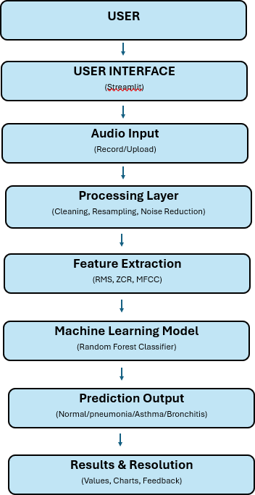
System Architecture
User provides respiratory audio
Audio is preprocessed for noise removal
Features extracted: MFCC, RMS, ZCR
Model predicts respiratory condition
Results displayed with values and charts

Slide 7
Hardware requirements for development & deployment
Tool | Version | Usage
Desktop | Windows 10/11 | Running the application
Processor | Intel i5 10th Gen / Ryzen 5 3500U or above | Fast computation and model execution
RAM | 8 GB DDR4 or above | Smooth processing of audio data
Microphone | Built-in / External 16-bit, 44.1 kHz | Recording respiratory audio input
Storage | 256 GB SSD or above | Storing datasets and model files
Internet Connection | 10 Mbps or above | Downloading datasets and deployment

Slide 8
Hardware requirements for development & deployment
Technology | Version | Usage
Python | 3.10+ | Core programming language
Anaconda | 2023.X | Environment setup and package management
Streamlit | 1.30+ | User interface for audio upload and results
Librosa | 0.10+ | Audio preprocessing and feature extraction
NumPy | 1.24+ | Numerical computations
Scikit-learn | 1.3+ | Machine learning model implementation
Matplotlib | 3.7+ | Visualization of waveform and features
Jupyter Notebook | 6.x/7.x | Model development and testing

Slide 9
Implemenation
Environment setup using Python and Anaconda
Installation of required libraries (Librosa, NumPy, Scikit-learn)
Audio input collected through microphone or uploaded file
Preprocessing of audio (noise removal, normalization)
Feature extraction using MFCC, RMS, and ZCR
Machine learning model trained using extracted features
Model prediction integrated with Streamlit interface
Results displayed to the user in real time

Slide 10
Module(s)Description
Name of the module | Description of the module
User interface Module | Allows the user to upload respiratory audio and view the prediction results.
Audio processing Module | Clean the audio signal by removing noise, normalizing amplitude, and improving quality.
Feature extraction Module | Extracts important feature such as MFCC, RMS, Zero Crossing Rate(ZCR).
Machine Learning Model Module | Uses extracted features to classify the respiratory condition using a trained model.
Prediction Module | Generates the predicted output based on model analysis.
Result Visualization Module | Display the detected condition and feature value in a user-friendly format.

Slide 11
Results & Discusion
System successfully processes respiratory audio inputs
Feature extracted: MFCC, RMS, ZCR
Model predicts conditions: Normal, Asthma, Bronchitis, Pneumonia
Achieved good classification accuracy(~85 -90%)
Different patterns observed for each disease
Results vary slightly due to noise and recording conditions
System provides fasr and real-time prediction

Slide 12
Conclusion & Future Enhancement
Add advanced AI models to improve accuracy and prediction capability
Integrate real-time data processing for better performance
Develop a mobile application version for wider accessibility
Enhance UI/UX design for a more interactive user experience
Implement cloud deployment for scalability and storage
Add security features like authentication and data encryption
Include more features based on user feedback and real-world usage
Expand the system to support multiple domains or use cases

Slide 13
References
B. Logan, Mel Frequency Cepstral Coefficients for Music Modeling, ISMIR, 2000
L. Rabiner & B. H. Juang, Fundamentals of Speech Recognition, 1993
T. Giannakopoulos, Introduction to Audio Analysis, 2014
A. Bardou et al., Lung Sound Classification Using CNN, 2018
Pramono et al., Automatic Respiratory Sound Analysis, 2017
Kaiming He et al., Deep Residual Learning (ResNet), 2016

Slide 14
References
Sepp Hochreiter & Jürgen Schmidhuber, Long Short-Term Memory (LSTM), 1997
Alex Krizhevsky et al., ImageNet Classification with CNN, 2012
Ian Goodfellow et al., Deep Learning, MIT Press, 2016
ICBHI Respiratory Sound Database (2017) & Coswara Dataset (IISc Bangalore, 2020)

Slide 15
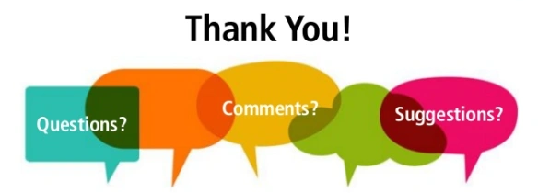
Project Title : BREATH CARE-AI-POWERED AUDIO BASED ANALYSIS APP FOR RESPIRATORY DISEASE PREDICTI
Batch-ID: 24
Student Team Members:
Bolenane Kusuma,2451-22-749006
Police Karthik Reddy,2451-22-749-057
K.Rajesh kumar,Assistant professor, Dept. of CSE, MVSREC

